Slide 1

Used Luxury Cars Price Prediction
Team members:
Hazim Bukhari
Amena AlSamah
Rashed AlHilal

Slide 2


Business Problem
A new luxury used cars dealership is opening.
Currently used cars pricing is done manually.

Slide 3

Why are we doing this?
Save Time.
Cost Efficient.
More Accurate.

Slide 4
How are we going to do it?
Collect Data from cars.com
Extract insight.
Build multiple ML models.
Choose the best model.

Slide 5
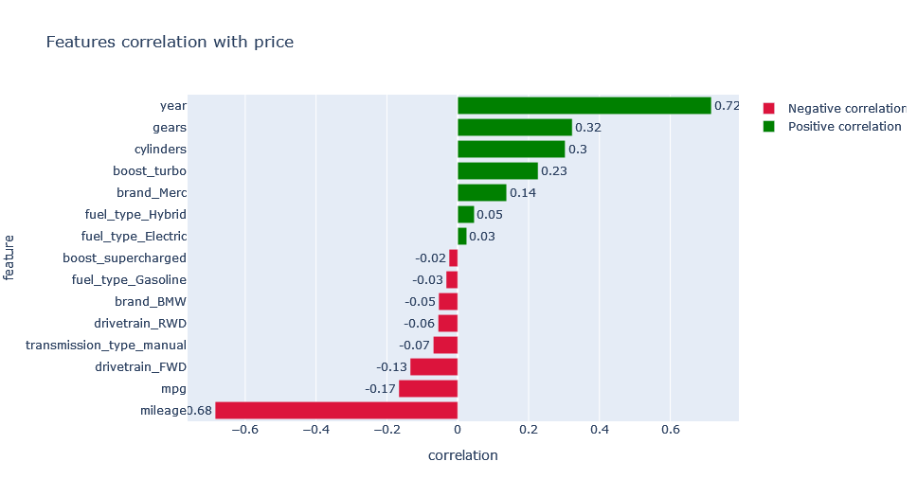
Findings

Slide 6
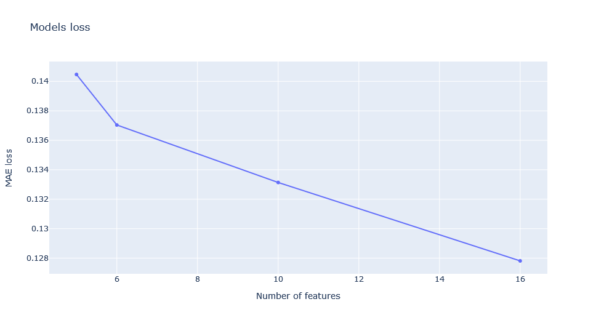
Findings Cont.

Slide 7
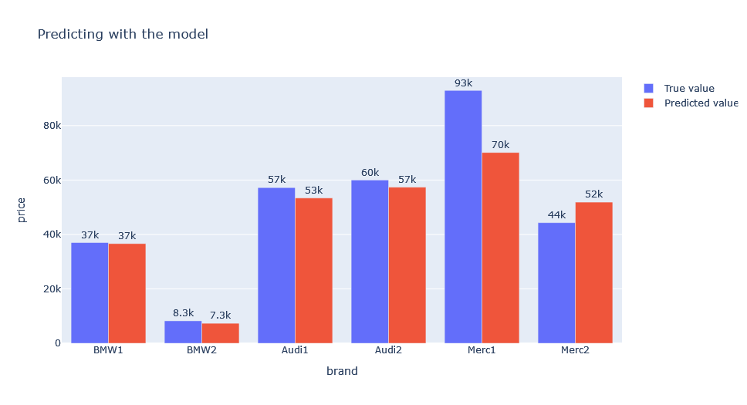
Predicting

Slide 8

Conclusion
We observed that the most important factors in predicting the price are:
Year.
Cylinders.
Is it Electric.
MPG.
Mileage.

Slide 9

Recommendation
Auto pilot.
Auto cruse control.
Self parking.
Another model can be done such as economy car prediction

Slide 10

Have a great day!

